Slide 1
Light Field Imaging Toolbox

Slide 2
Design goals
Modular
Extensible
Interfaces and implementations
APIs/SPIs... accessible from notebooks or napari
Interoperable
Light Field Imaging (napari plugin)
adapters to ImageJ, ImgLib2, Bioformats,

Slide 3
Modules
design interfaces for the entire workflow, regardless of implemention
LFAcquire (using umgr?, later)
LFMeta, LFData
LFData.import, transform
LFCalibrate
LFRectify
LFDeconvolution
LFDeepLearn, LFInference
LFView… LFDisplay

Slide 4
Data and Metadata
Metadata
LFMeta specify metadata req'd
LFData + utilizes LFMeta
napari metadata?

Slide 5
???
Leveraging napari infrastructure…
GUI
MagicGUI
QtPy (abstraction layer over PyQT, PySide)
Leverage VizPy, Scikit-image, …
(Later…) Acquisition, camera control, drivers → Micromanager?

Slide 6
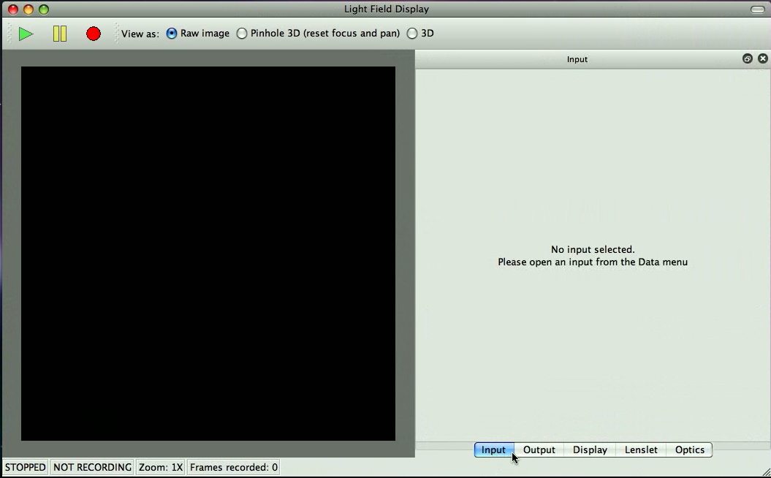

LFDisplay – Main window

Slide 7
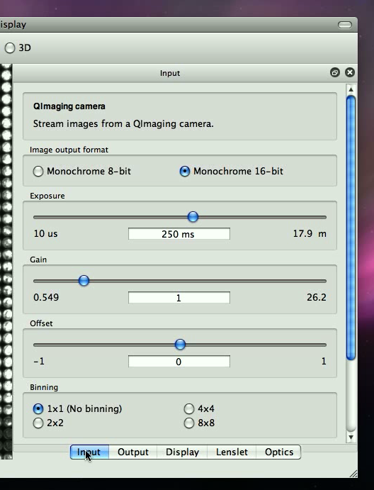
Input
Camera control

Slide 8
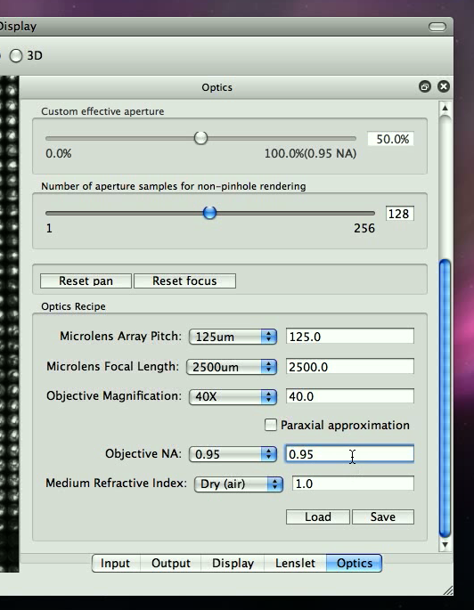
Optics [Config]

Slide 9
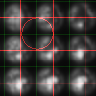
Lenslet

Slide 10
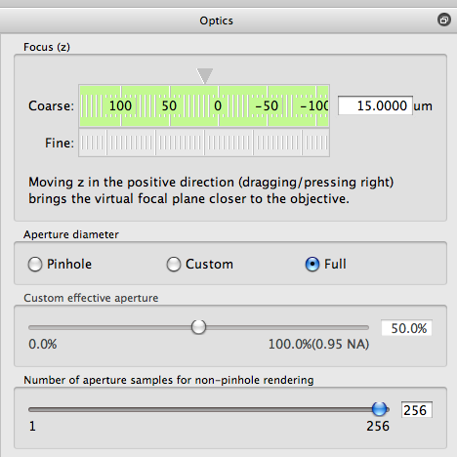
Optics [Explore]

Slide 11
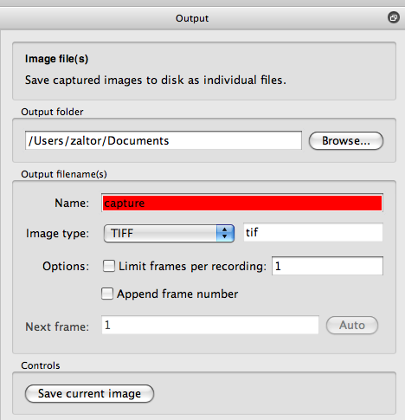
Output9

Slide 12
ImgNav…
Py version of ImgNav... in python?
add subdir organization and metadata/description/notes in file descibeme.
preview image. preview.tif [gif, jpg, png] with tiff [single|multiple page]]?
specify representative thumbnail
like a readme.

